Slide 1
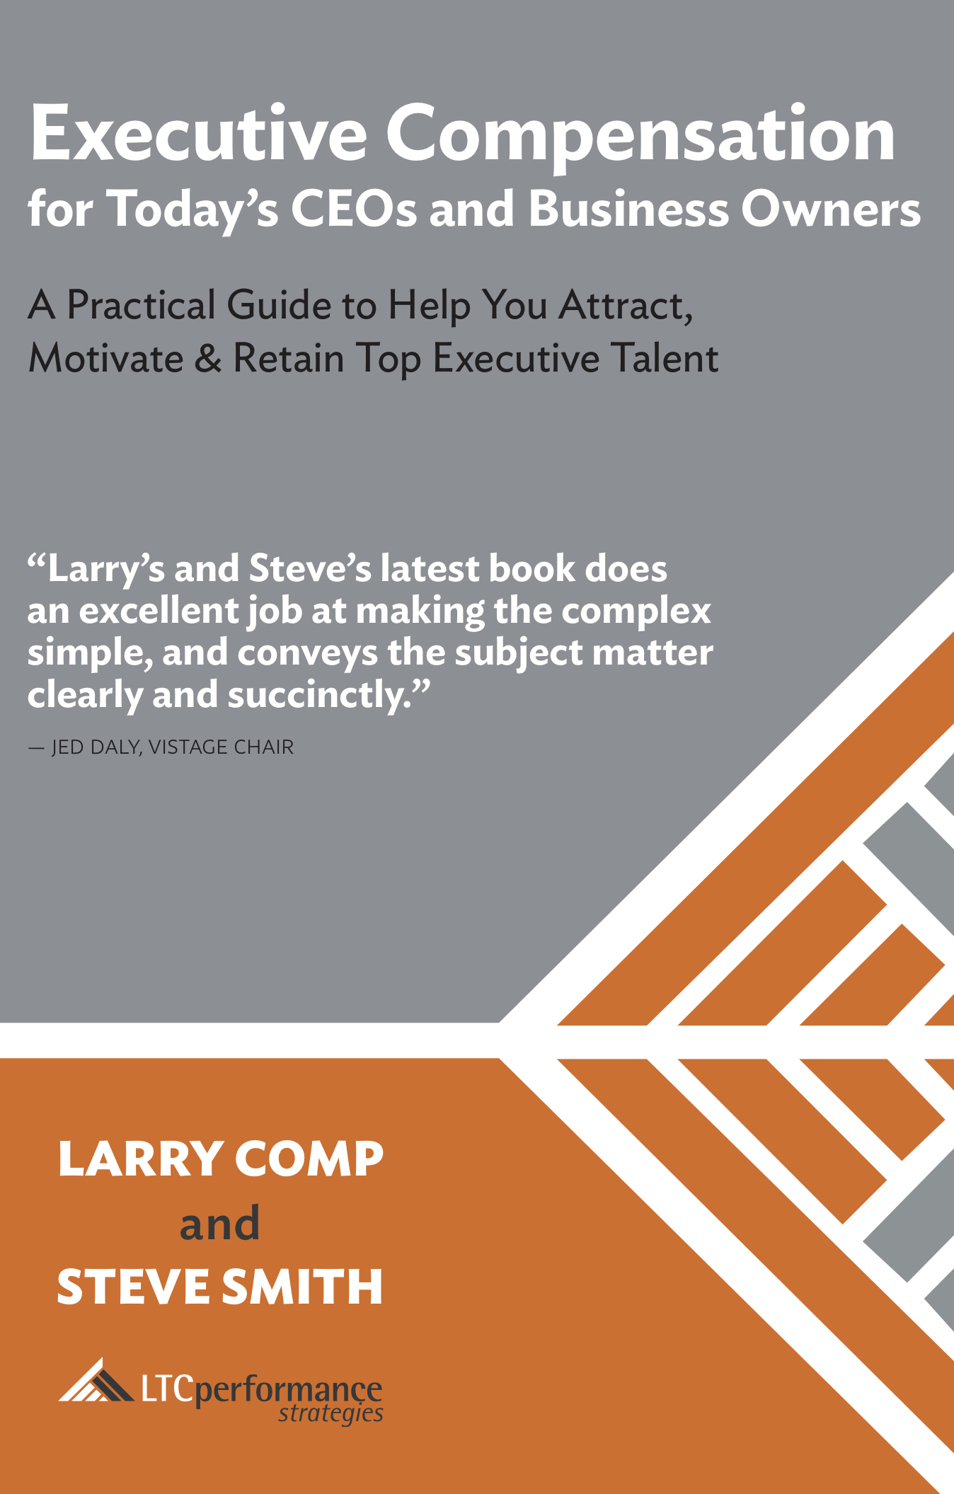
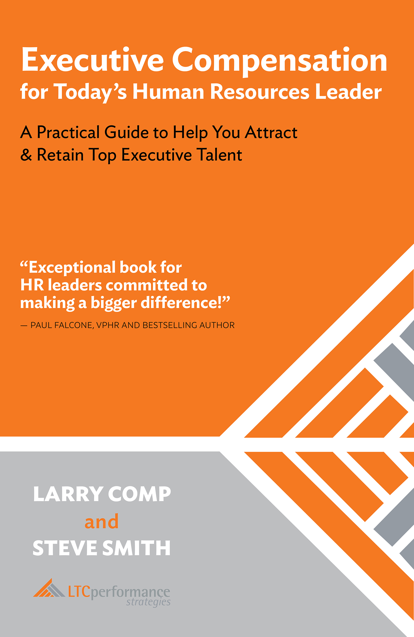
LTC is a Nationally-Recognized Thought Leader:

Slide 2
Larry B. Comp, Principal
Larry Comp serves as the LTC Performance Practice Leader for High Performance and Total Compensation Solutions. Larry is a widely recognized authority in the field, having supported over 850+ organizations across 50+ industry segments. These include the design, development, and implementation of:
Executive Compensation/Benefits
Sales & Incentive Compensation
Salary Management
Larry’s passion is leveraging pay-for- performance relationships, to create healthy, “high performance” cultures. Client organizations frequently report increased productivity, profitability & value, as well as improved teamwork and ownership.
Prior to joining LTC, Larry held progressively responsible leadership roles with Baxter Healthcare and Nissan. He holds a Masters Degree in Human Resources Management, has been accredited as a Senior Professional in Human Resources (SPHR), and recognized as a Certified Management Consultant (CMC). In addition, Larry has co-authored numerous publications and taught undergraduate/ graduate classes for several universities. He has been a member of several Boards and currently serves on the Compensation Committee of a major private corporation. He is the co-author of the following books: “Executive Compensation for Today’s CEOs and Business Owners;” “Executive Compensation for Today’s Human Resources Leader;” & “Executive Compensation for Private Company CEOs and Business Owners.”

